Slide 1
Cloud & Cyber Security Expo 2022
Moving to the Cloud Securely with
DevSecOps
Vince King
March 2022

Slide 2
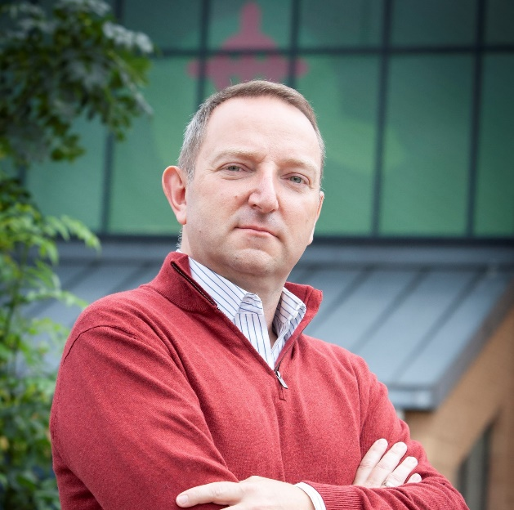





#whoami
Vincent King
Head of DevSecOps for Cloud Transformation
Socio-Technical Security Posture Management
Bank of England
Vincent.king@bankofengland.co.uk
Reformed Developer
Secure Coding Subject Matter Expert
DevSecOps Advocate
Qualys Certified Specialist
(ISC)² Certified Information Systems Security Professional
LinkedIn: https://www.linkedin.com/in/vincent-j-king
OFFICIALGREEN

Slide 3




DevOps vs Security – The Perception
Dev
Dev
Sec
Ops
OFFICIALGREEN

Slide 4

Where should Sec live?
Sec
Sec
Sec
Ops
Dev
Security Everywhere
OFFICIALGREEN

Slide 5

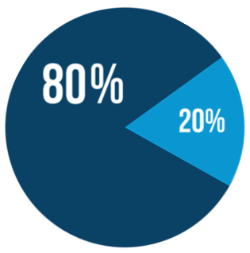
Where should Sec live?
Sec
Sec
Sec
Ops
Dev
Security Everywhere
Secure coding training
Code reviews
SAST
Secure code reuse
Gold container images
Secure code champions
Peer oversight
High trust team
Open Source code use
Newer container images
OFFICIALGREEN

Slide 6


Where should Sec live?
Sec
Sec
Sec
Ops
Evidence-based
policy setting
Dev
Security Everywhere
Documented
Use Cases
Policy
enforcement
CI/CD
pipelines
Infrastructure
as code
Challenge non-standard
architecture
OFFICIALGREEN

Slide 7


Where should Sec live?
Sec
Sec
Sec
Ops
Dev
Destroy &
rebuild
Continuous
monitoring
Security Everywhere
Vulnerability
Management
Threat
Intelligence
Policy
compliance
Proactive
patching
Posture management
reporting
OFFICIALGREEN

Slide 8





Vince’s Five Rules of DevSecOps in the Cloud
3
Set policies and enforce them through automation
1
Use the benefits cloud platforms gives you
2
Automate everything; where you can’t automate, secure the manual process
4
Report on compliance and make the data available to all teams
5
Tooling cannot fix all your problems, invest in people and processes
OFFICIALGREEN

Slide 9


And Finally…
Sec
Sec
Sec
Ops
Dev
Questions?
Security Everywhere
Vincent King
Head of DevSecOps for Cloud Transformation
Socio-Technical Security Posture Management
Bank of England
Vincent.king@bankofengland.co.uk
OFFICIALGREEN

